Slide 1


Stock Trading Recommendation System
Under the guidance of
Professor Ozgur Ozturk
Presented by
Chanakya Shiva Teja Polisetty
Sandeep Reddy Tamma
Pardha Saradhi Mogilipaka

Slide 2
Introduction
A Stock recommendation system can analyze large amounts of data using machine learning algorithms. It can identify different patterns and trends in the dataset and can give meaningful insights which might be difficult for humans to detect.
This recommendation system can help the investors to understand the performance of individual company stocks which can help them make more informed decisions about when to buy, sell or hold a stock.
The stock recommendation system can provide investors with objective analysis that is not influenced by any emotions or biases. It can help them make rational decisions and avoid making decisions based on gut feelings or other factors.
It analyses the previous performance of the company and the previous stock prices and will analyze the perfect time to hold and sell a stock.

Slide 3
Overview
We collected the data from the yahoo finance website (https://finance.yahoo.com).
The dataset consists of important features like Date, Opening price, Closing price, High, Low , Adj close , Volume related to the stocks of different companies.
We discovered many insights from the data while working on the project.
Our project tries to provides recommendations on whether to buy or sell stocks by analyzing trends in stock prices.
We made our stock recommendation system dynamically which helps us to select any start date and end date and any set of companies to analyse.

Slide 4
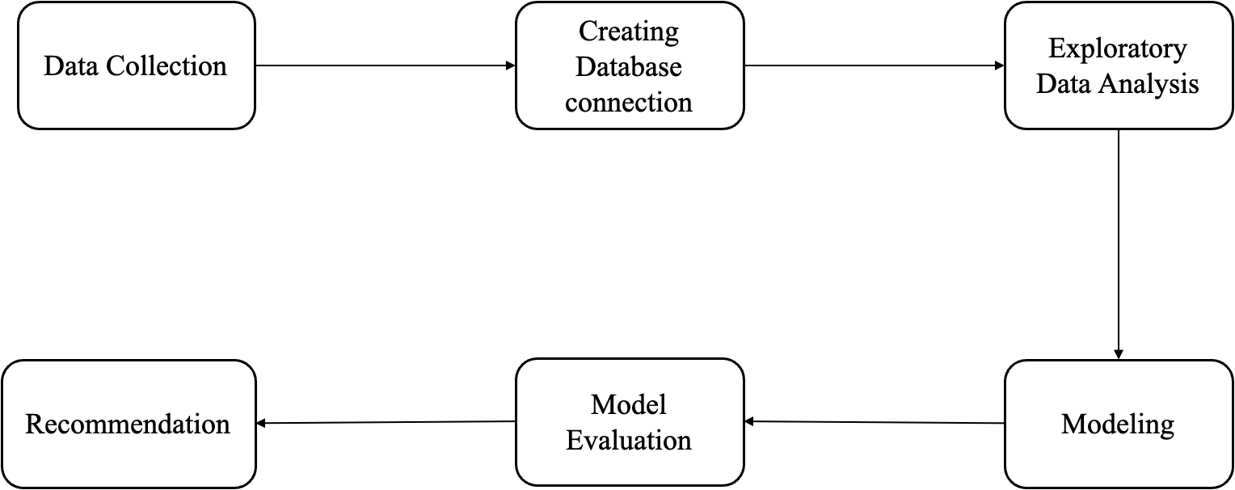
Project Overview

Slide 5
Data Collection
In this project, we are fetching the data from Yahoo Finance by importing the yfinance package.
We collected the data from the yahoo finance website. We have chosen the GICS (Global Industry Classification Standard) Sector to be Information Technology and the the GICS Sub-Industry to be Semiconductors.
The fetched data is stored in the database. We are using MySQL as our database and we are connecting the database with the help of sqlalchemy and pymysql libraries.
We have shortlisted all the companies which are in semiconductor industry with the following ticker names: AMD, ADI, AVGO, GFS, INTC, MCHP ,MU, NVDA, NXPI, QCOM, TXN.
We have taken the historical data of these companies from 1st January 2017 till 1st January 2023.

Slide 6
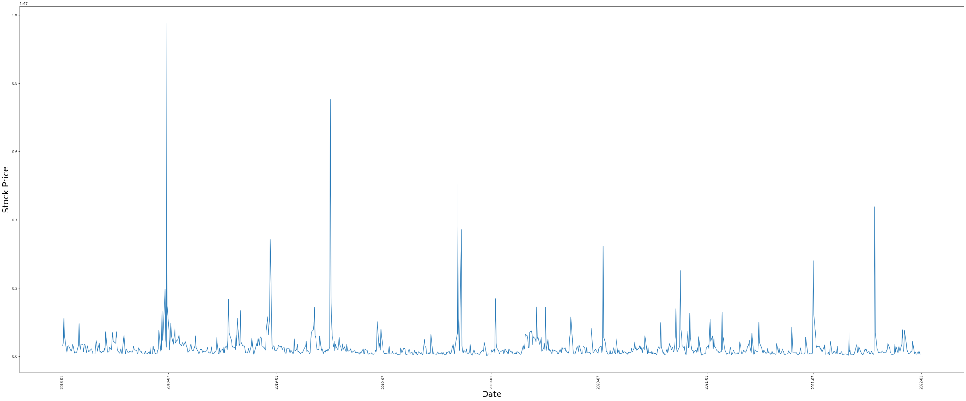
Exploratory Data Analysis
We are plotting the closing price of a stock over the years

Slide 7
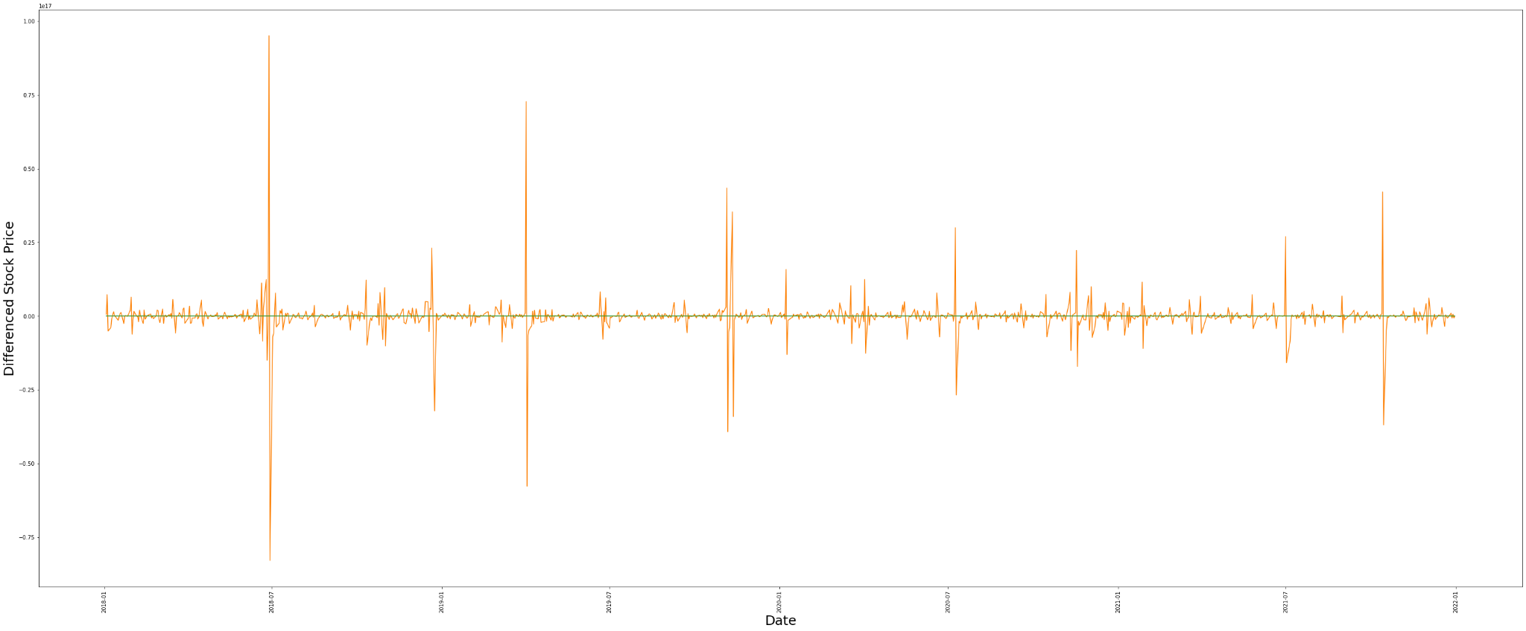
Exploratory Data Analysis
Differenced stock price

Slide 8
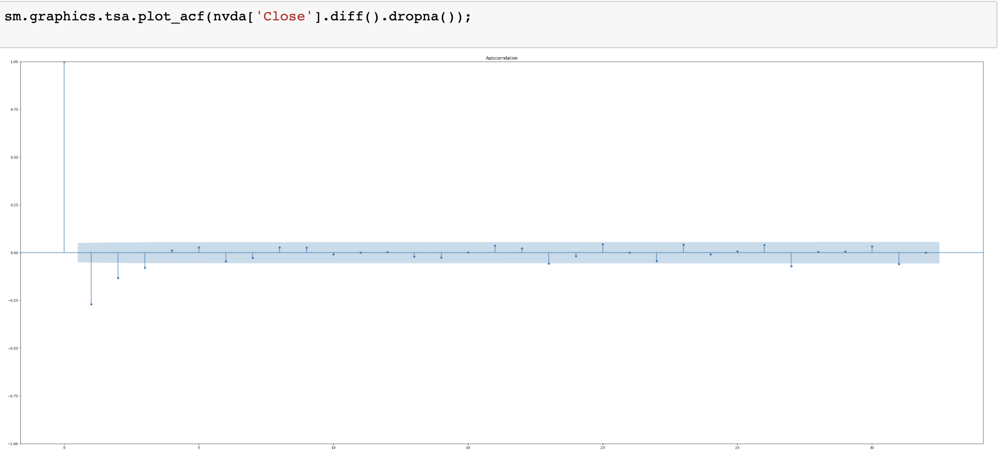
Exploratory Data Analysis
Auto Correlation Function for Stationary Data

Slide 9
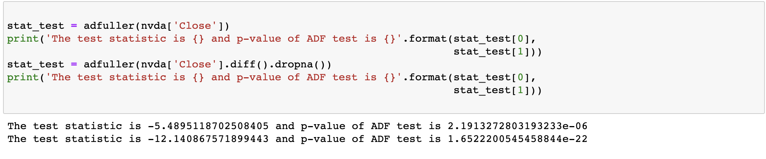
Exploratory Data Analysis Continued...
Augmented Dickey Fuller Test to check Stationarity

Slide 10
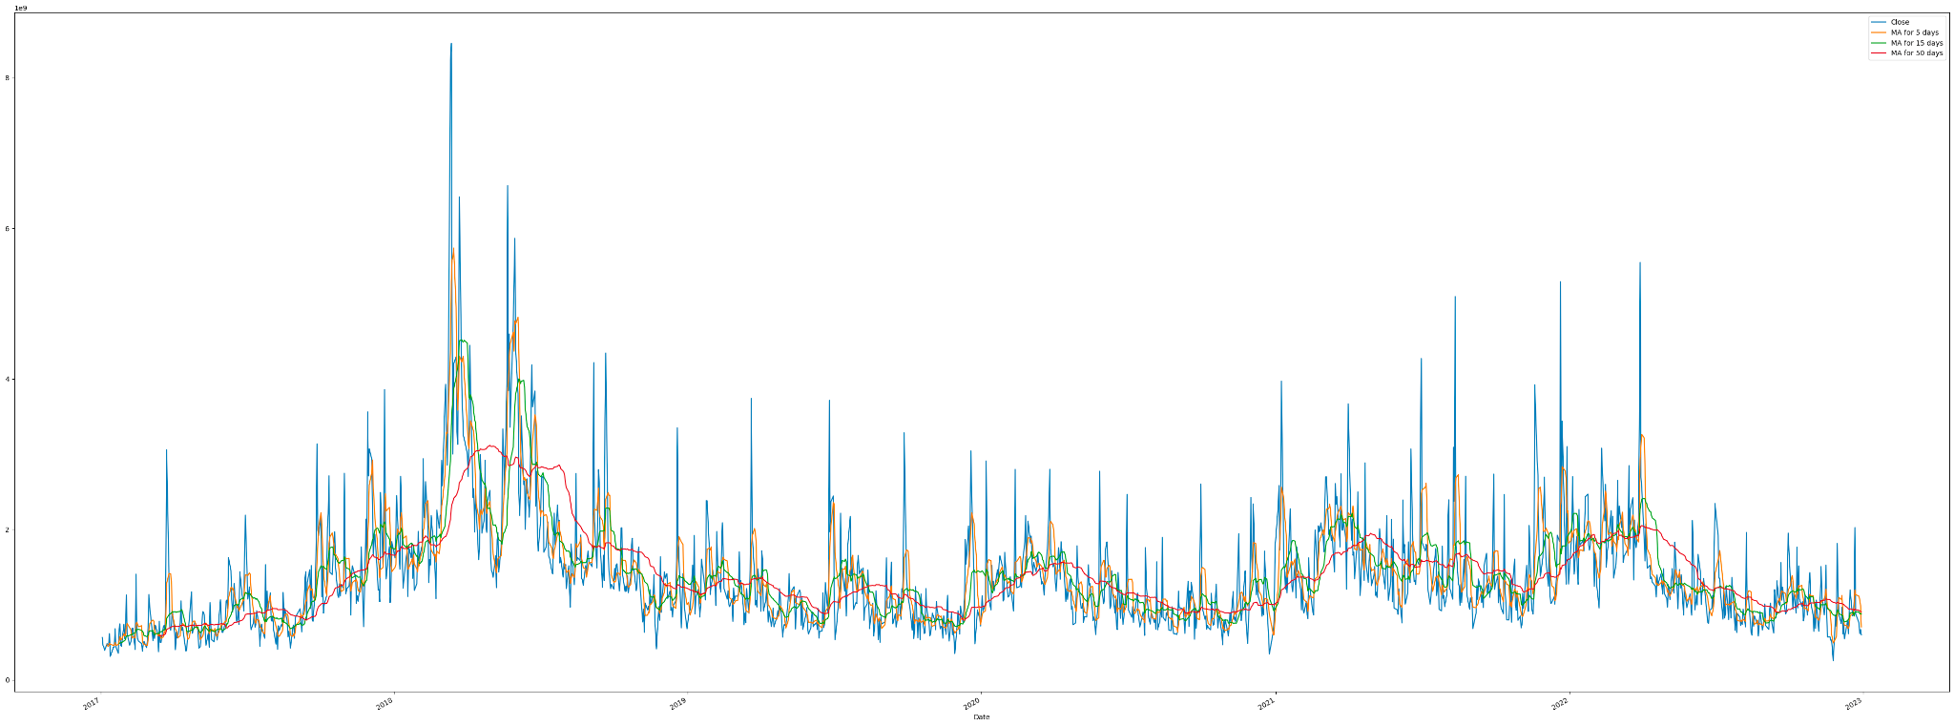
Exploratory Data Analysis Continued...
Mean Average for 5, 10 and 50 Days

Slide 11
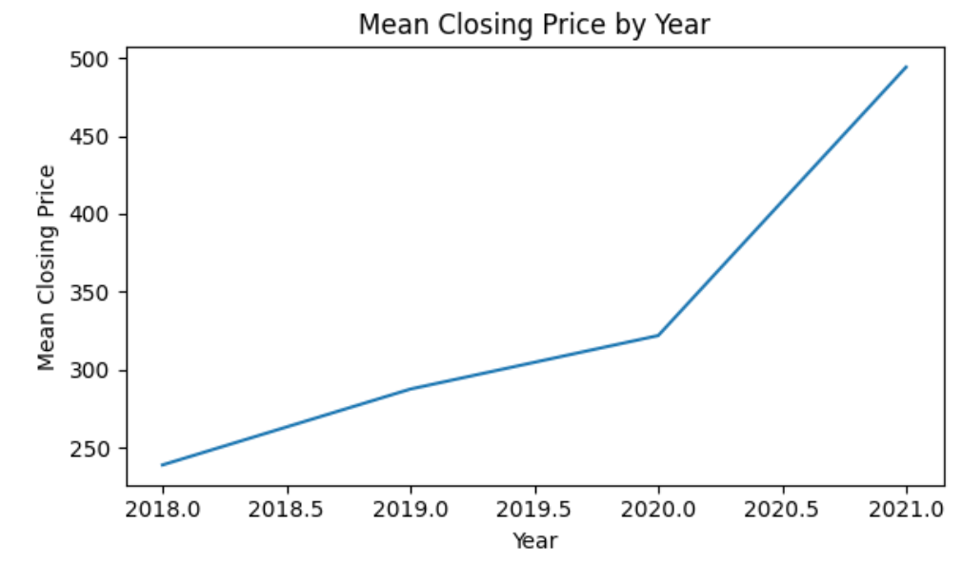
Exploratory Data Analysis Continued...

Slide 12
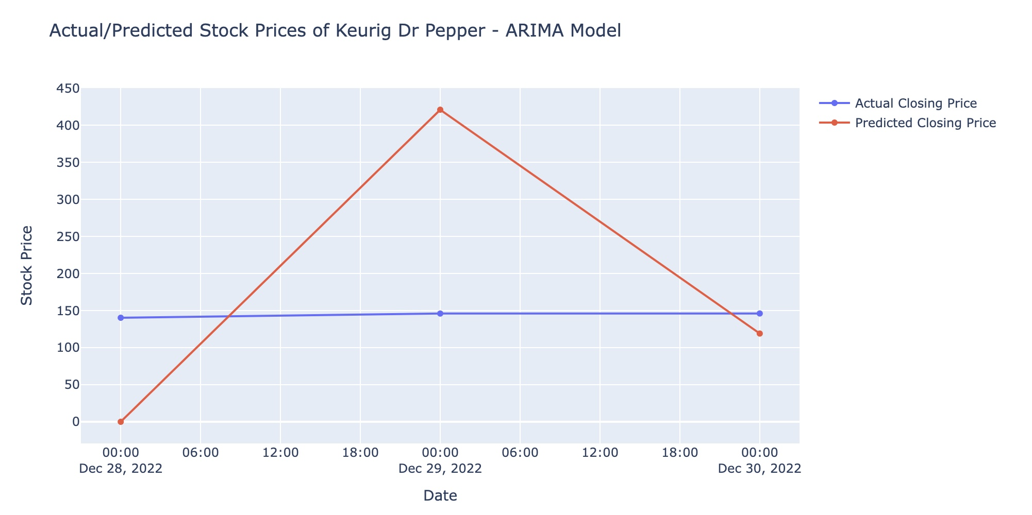
Autoregressive Integrated Moving Average(ARIMA)
ARIMA (Autoregressive Integrated Moving Average) model is a commonly used time series forecasting method that combines autoregressive (AR) and moving average (MA) models with a differencing pre-processing step.

Slide 13
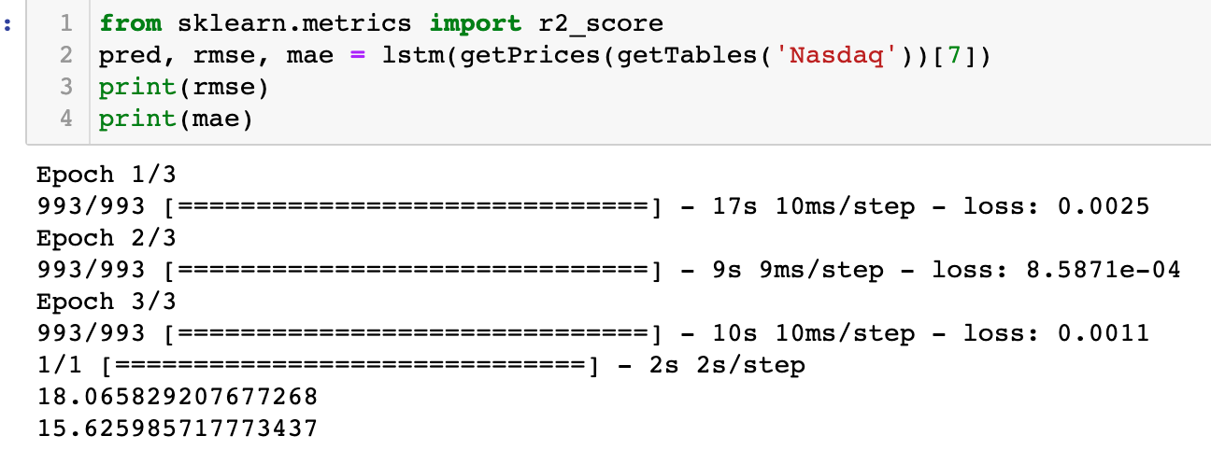
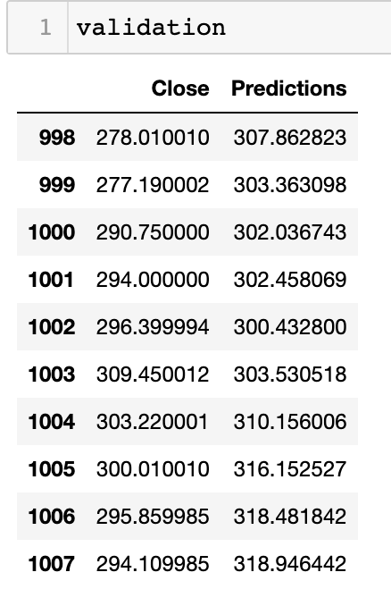
Long Short-Term Memory (LSTM)
LSTM (Long Short-Term Memory) is a type of recurrent neural network (RNN) that is particularly well-suited for modeling and forecasting sequential data. LSTMs are designed to selectively retain information over longer periods of time.
It can selectively retain and update information over multiple time steps through the use of memory cells and gating mechanisms.
We can find the actual close and predicted close values below.

Slide 14
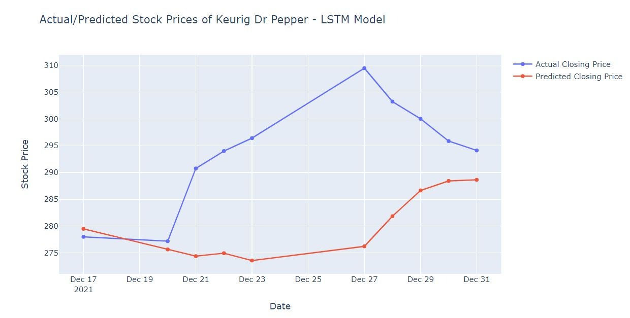
Long Short-Term Memory (LSTM)

Slide 15
Model Evaluation
For model evaluation we have chosen 2 methods. They are: Root Mean Square Error and Mean Absolute Error.
When using LSTM, the Root Mean Square Error between the actual stock price and the predicted stock prices was 18.06 and the Mean Absolute Error was 15.62.
Model | RMSE | MAE
LSTM | 18.06 | 15.62
ARIMA | 178.93 | 147.47

Slide 16
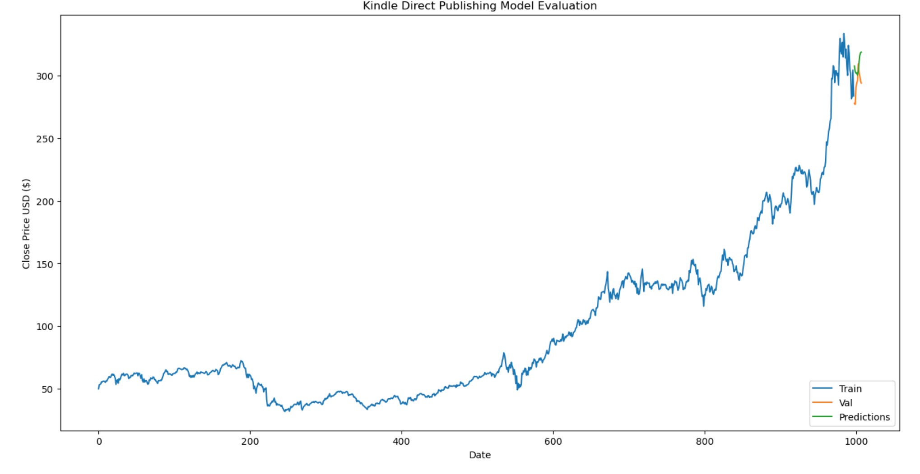
Model Prediction

Slide 17
Generate Buy and Sell Signals
Using MACD Strategy
Moving Average Convergence/Divergence (MACD) is a technique which can be used by traders and investors for various time frames, from intraday to long-term trading.
It helps to derive price indicator for day trading by including user risk factor.
MACD gives 3 values
MACD Line - Difference between 26 day Exponential Moving Average (EMA) and 12 day EMA
Signal Line - 9 day EMA of MACD
MACD Histogram - Difference between MACD and Signal Line
MACD Line crosses above the Signal Line - BUY
MACD Line crosses below the Signal Line - SELL

Slide 18
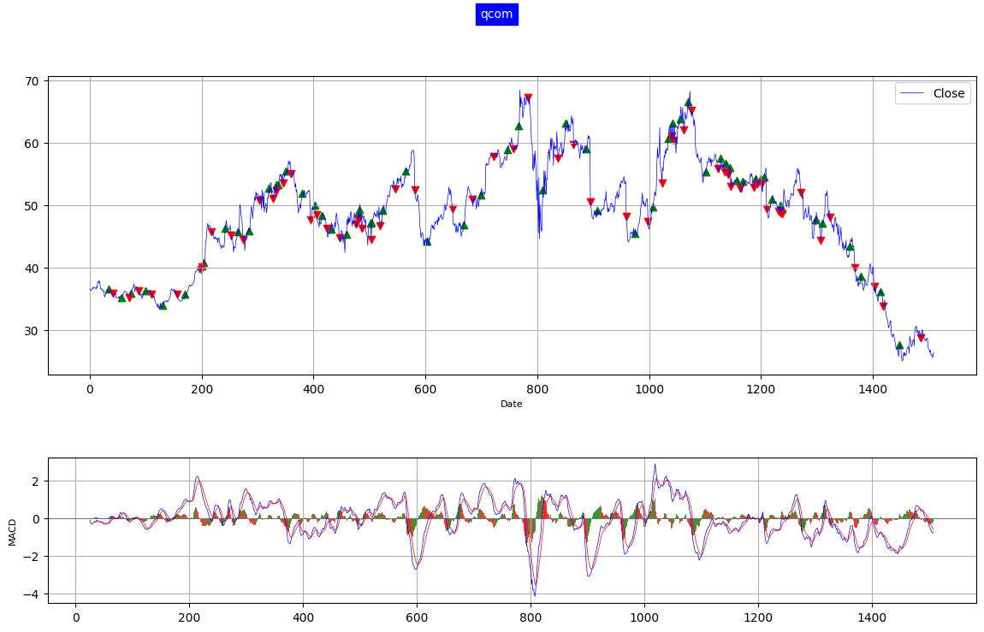
Trend Visualization using MACD

Slide 19
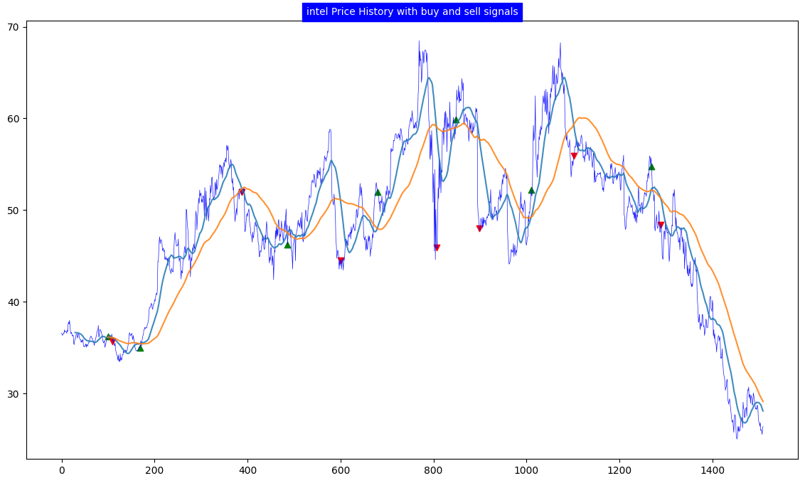
Generate Buy and Sell Signals
Using SMA Strategy
SMA stands for Simple Moving Average, which is a widely used trend-following indicator that helps to identify the direction of the trend and potential reversal points.
SMA is calculated by taking the average of a specified number of past closing prices of a security.

Slide 20
Generate Buy and Sell Signals
Using BB Strategy
BB stands for Bollinger Bands, which is a volatility-based indicator that consists of a set of three lines. The middle line represents the SMA, while the upper and lower lines are calculated based on the standard deviation of the security's price over a specified number of past periods.
The BB strategy involves waiting for the price of a stock to approach or cross the upper or lower BB.

Slide 21
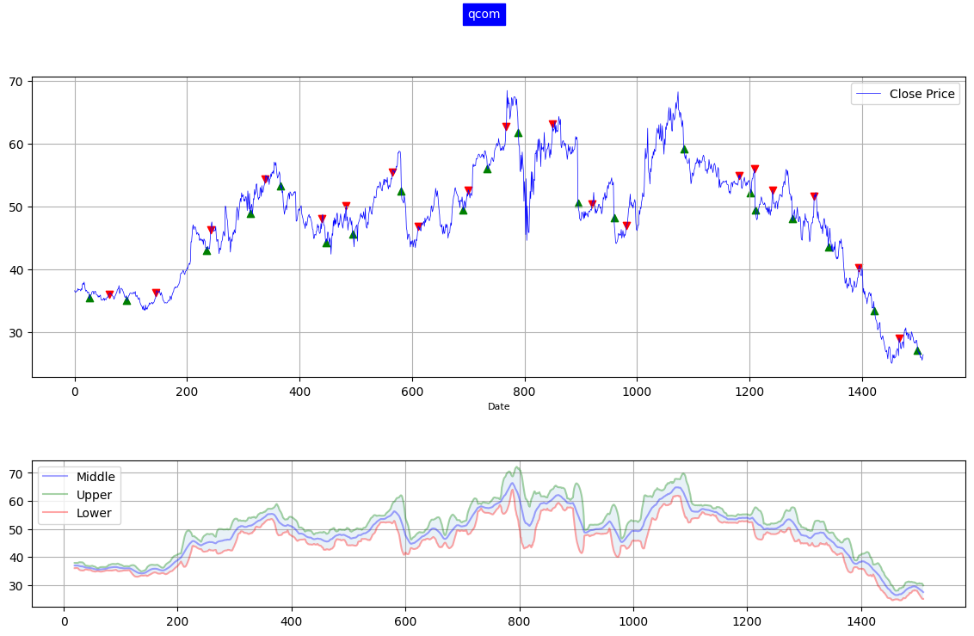
Trend Visualization using BB Strategy

Slide 22
References
https://machinelearningmastery.com/arima-for-time-series-forecasting-with-python/
https://finance.yahoo.com/
https://www.investopedia.com/articles/active-trading/052014/how-use-moving-average-buy-stocks.asp
https://machinelearningmastery.com/gentle-introduction-long-short-term-memory-networks-experts/
https://www.investopedia.com/trading/using-bollinger-bands-to-gauge-trends/

Slide 23


